Slide 1
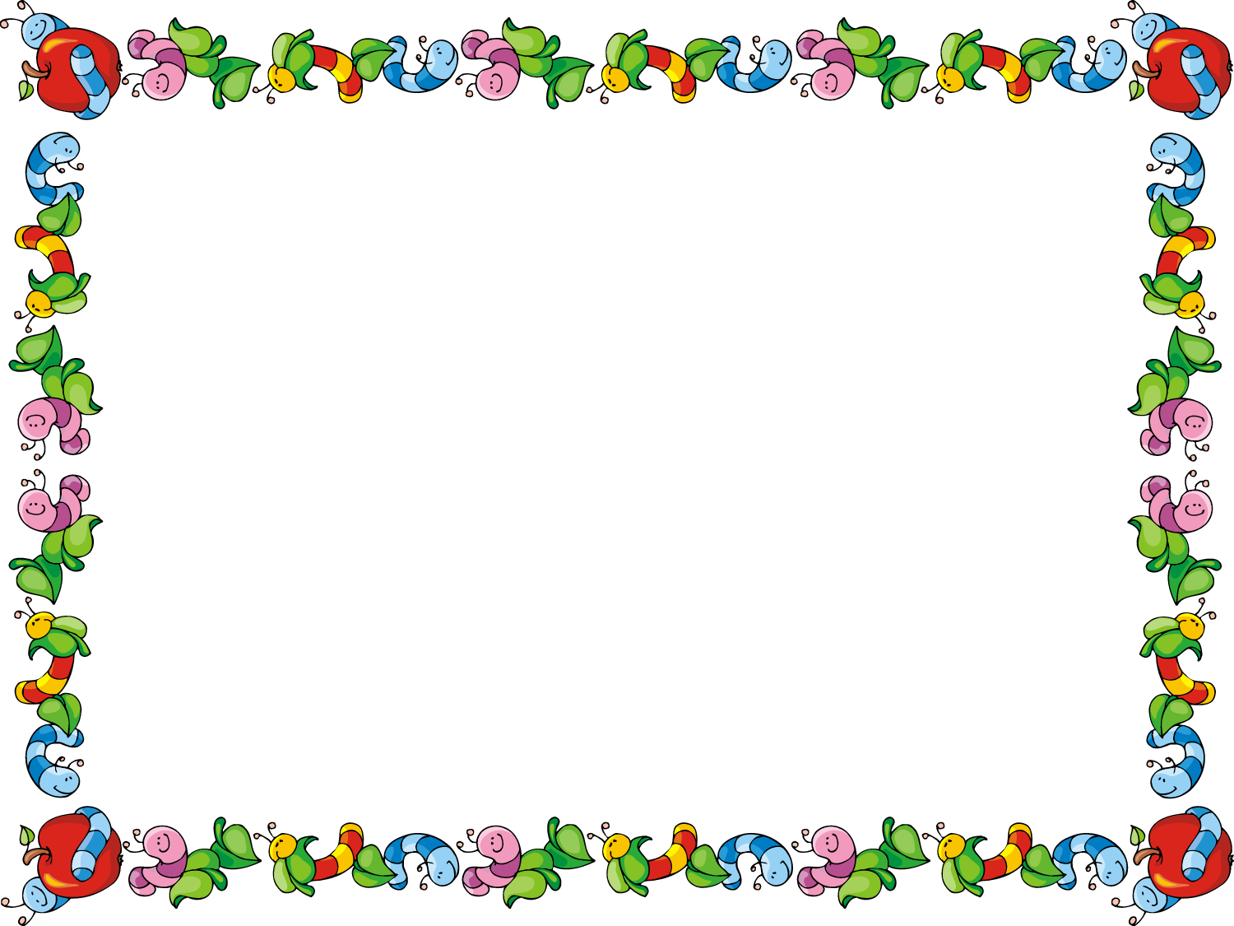
XAVRONICLE
NEWSLETTER (April to June 2022)
Grade- Pre-Nursery
A New School Year means New Beginnings, New Adventures and New Challenges !

Slide 2
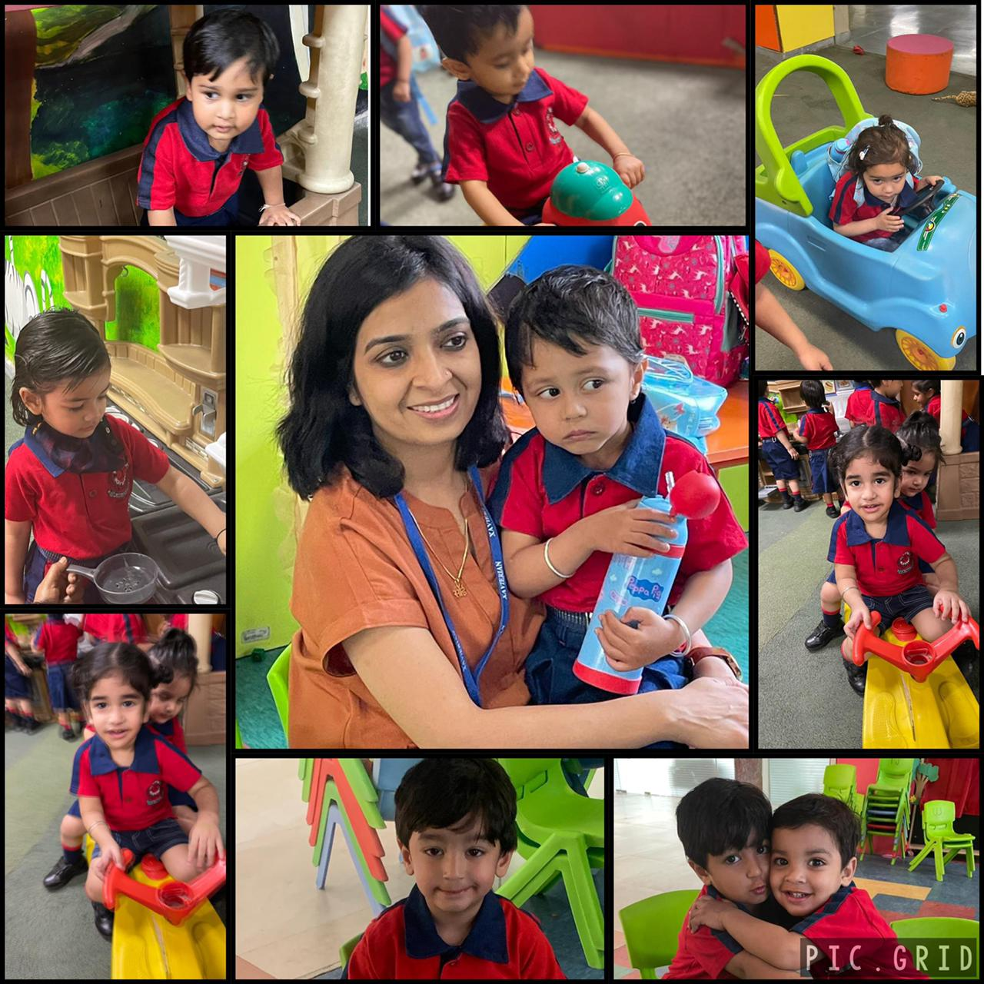
THE FIRST DAY OF SCHOOL !!

Slide 3
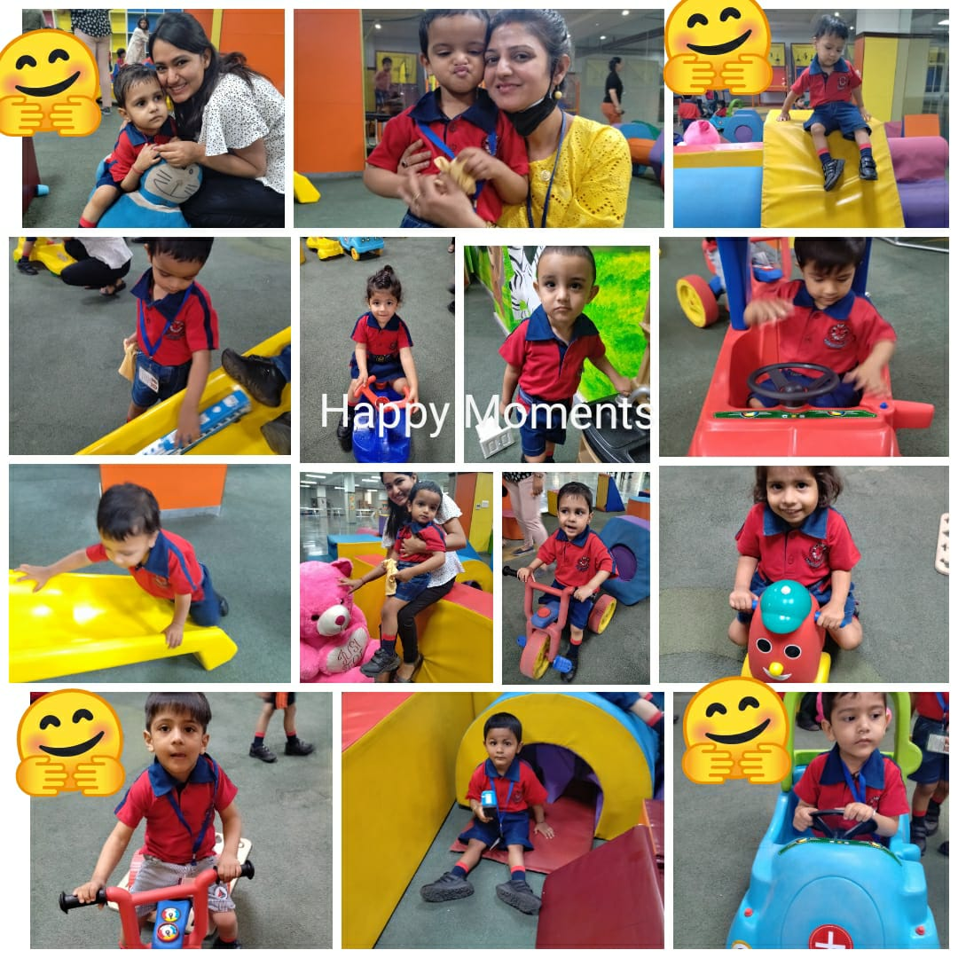

Slide 4
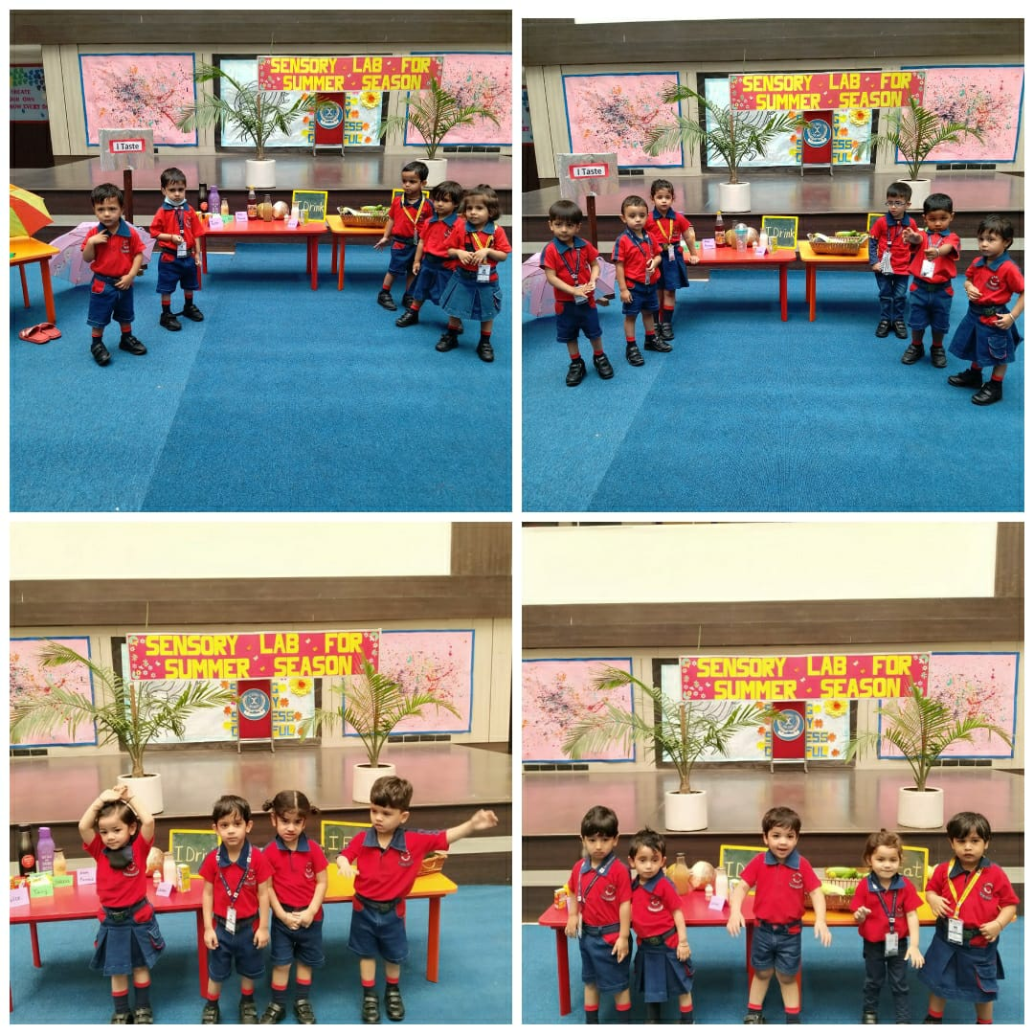
SUMMER SEASON
The Pre- Nursery children learnt about the ‘Summer Season’ in one of the most creative ways. Some enriching summertime activities were organized where they learnt about the happy and hot season. The children had hands-on experiences as they explored the various aspects of the summer season in the Sensory Lab- ‘I taste’, ‘I feel’, ‘I smell’, ‘I wear’ and ‘I like to’. Adding to the water melons and lassis, the big smiles and curious eyes of the little learners made the Sensorial Lab bright and lively. Happy Learning!!

Slide 5
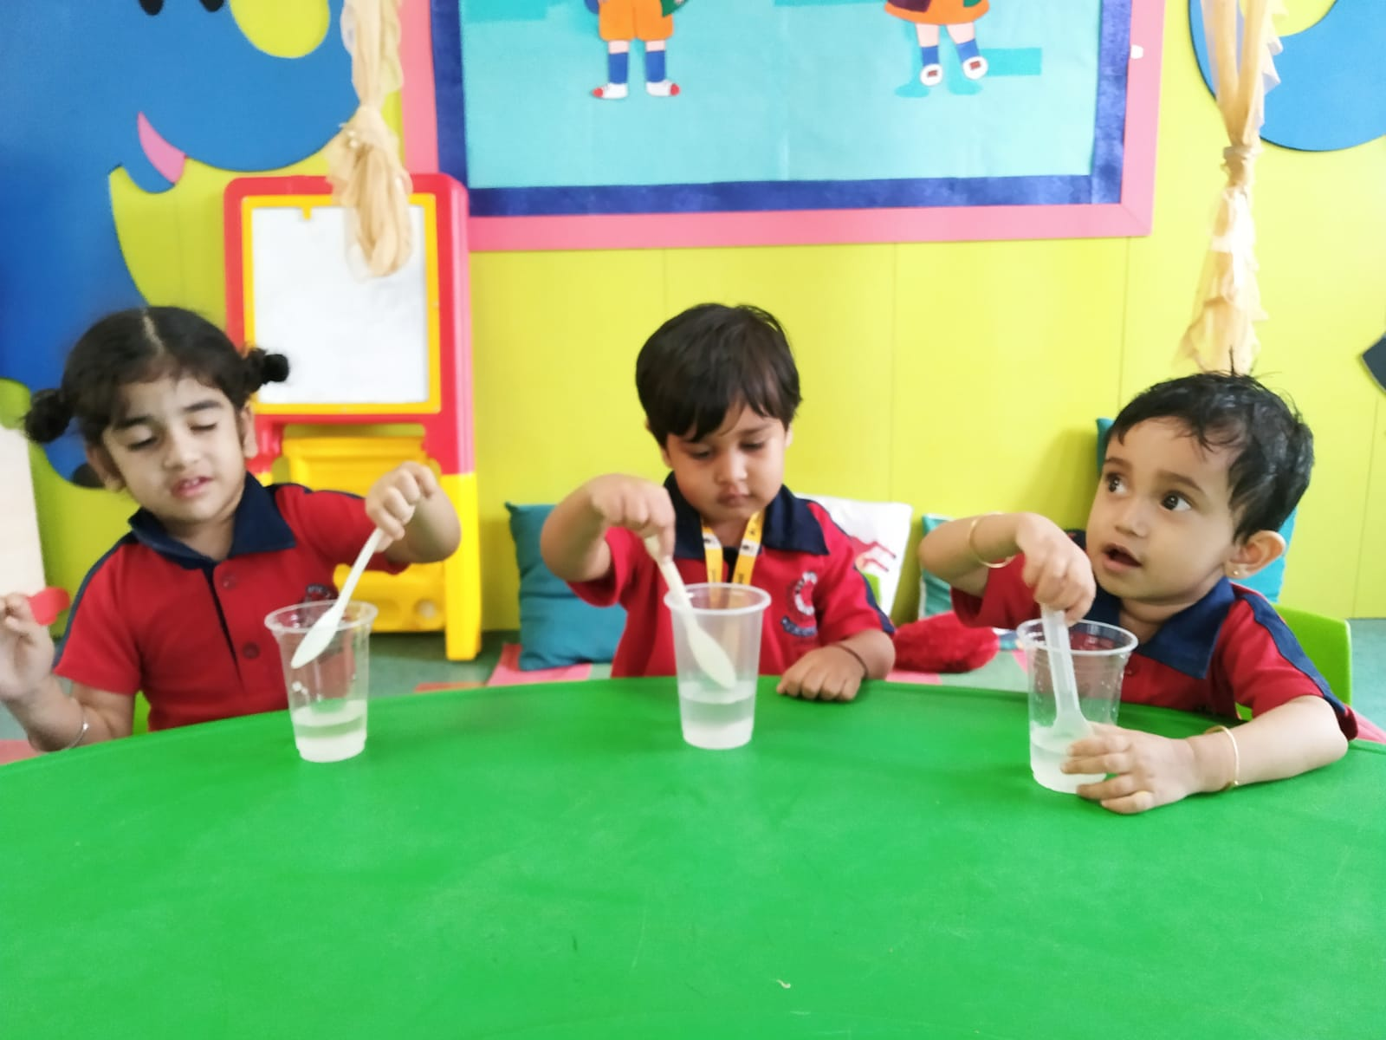
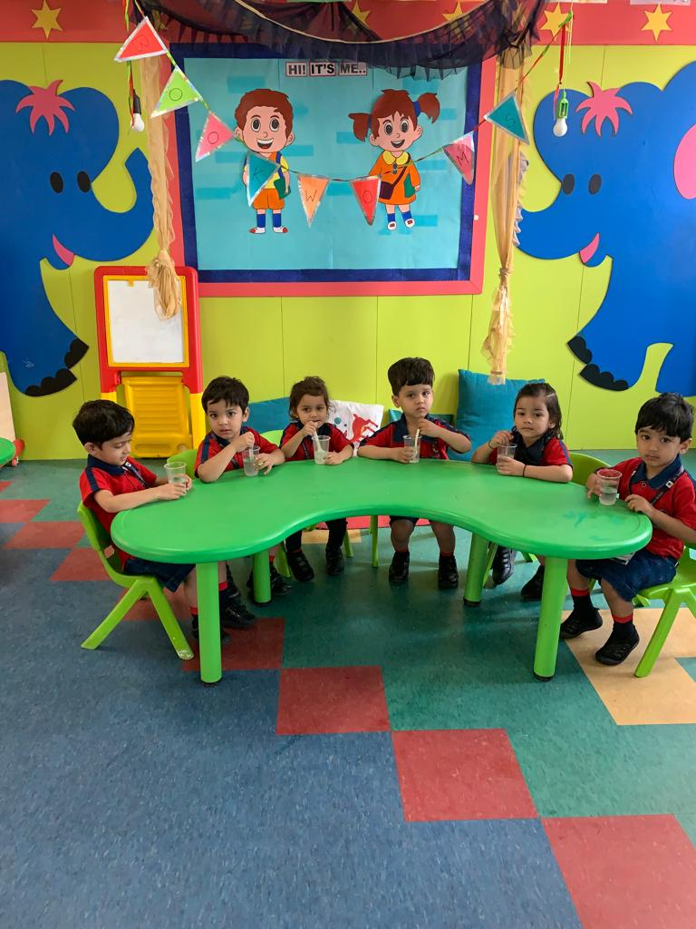
COOL LEMONADE

Slide 6
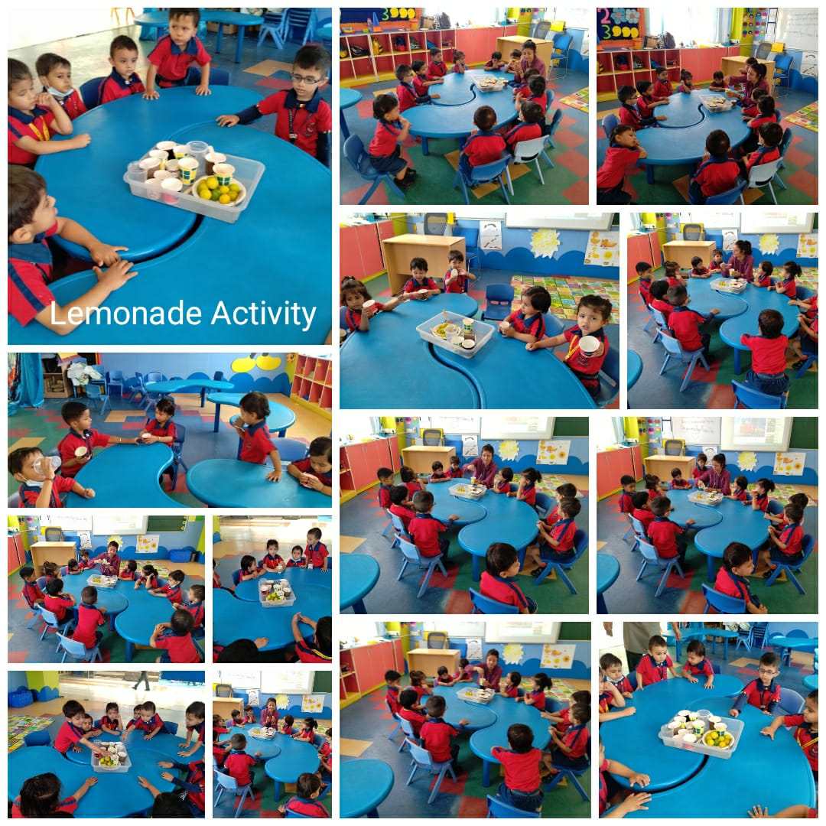

Slide 7
HAPPY MOTHER’S DAY
“No language can express the power and beauty and heroism of a mother’s love.”
The Pre-Primary wing of St. Xavier’s High school was filled with beautiful and positive vibes of motherhood as Pre-Nursery celebrated Mother’s Day. The classrooms were decorated to welcome the mothers and make them feel special. The little Xaverians surprised their moms by gifting them cute decorated hearts made out of clay. The mothers enthusiastically participated in some fun-filled games organized by the teachers in the classrooms. The unforgettable day ended with an energetic Zumba session followed by an emotional dance-song combination ‘ungli pakad ke’. The click of the cameras and laughter filled up the classrooms as the mothers left waiting to come back the next year.

Slide 8
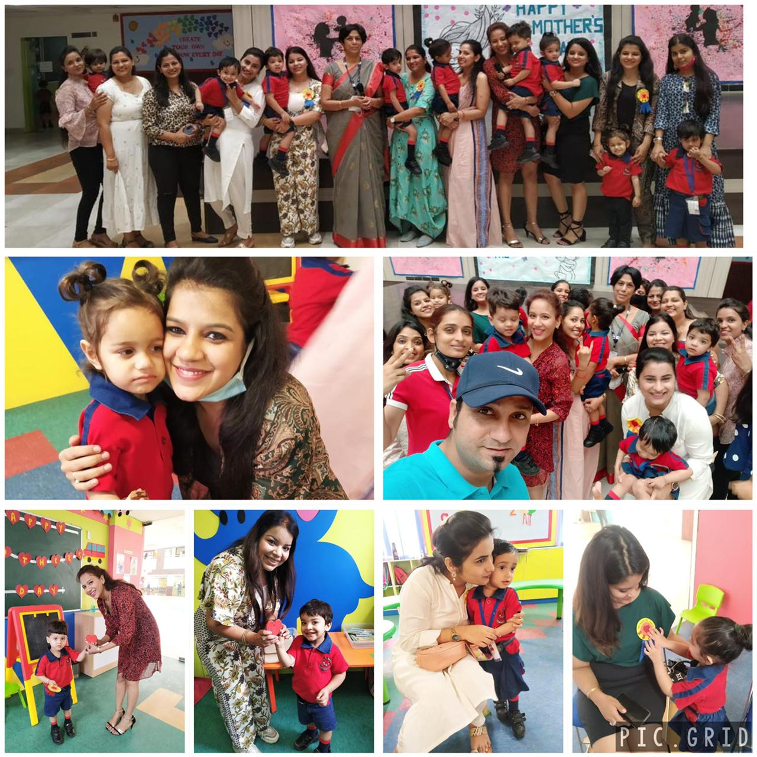
HEART TO HEART

Slide 9
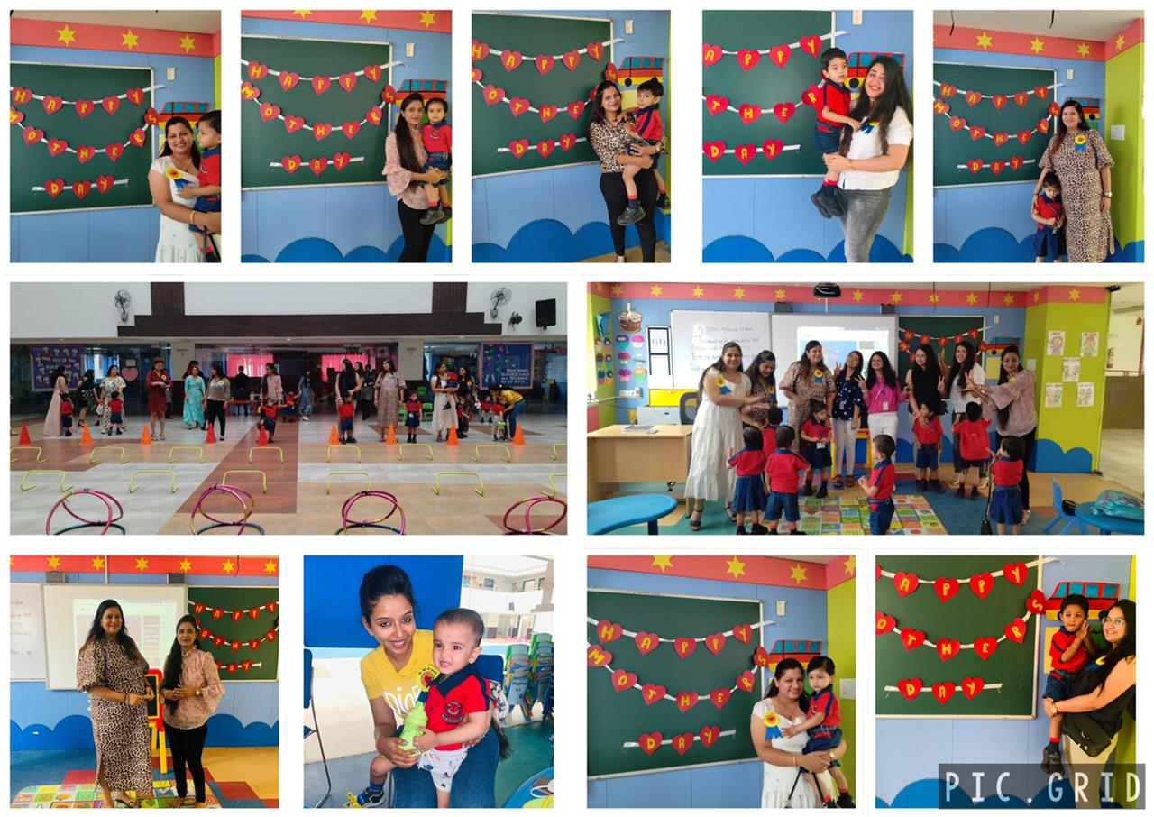
A VERY
SPECIAL DAY

Slide 10
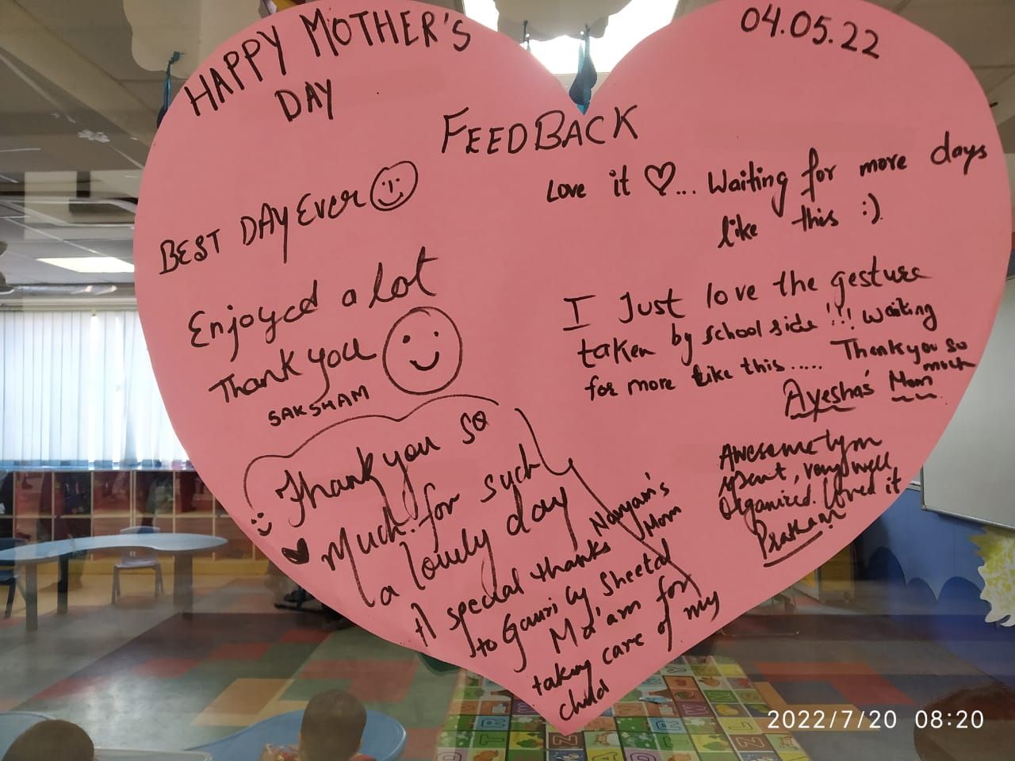
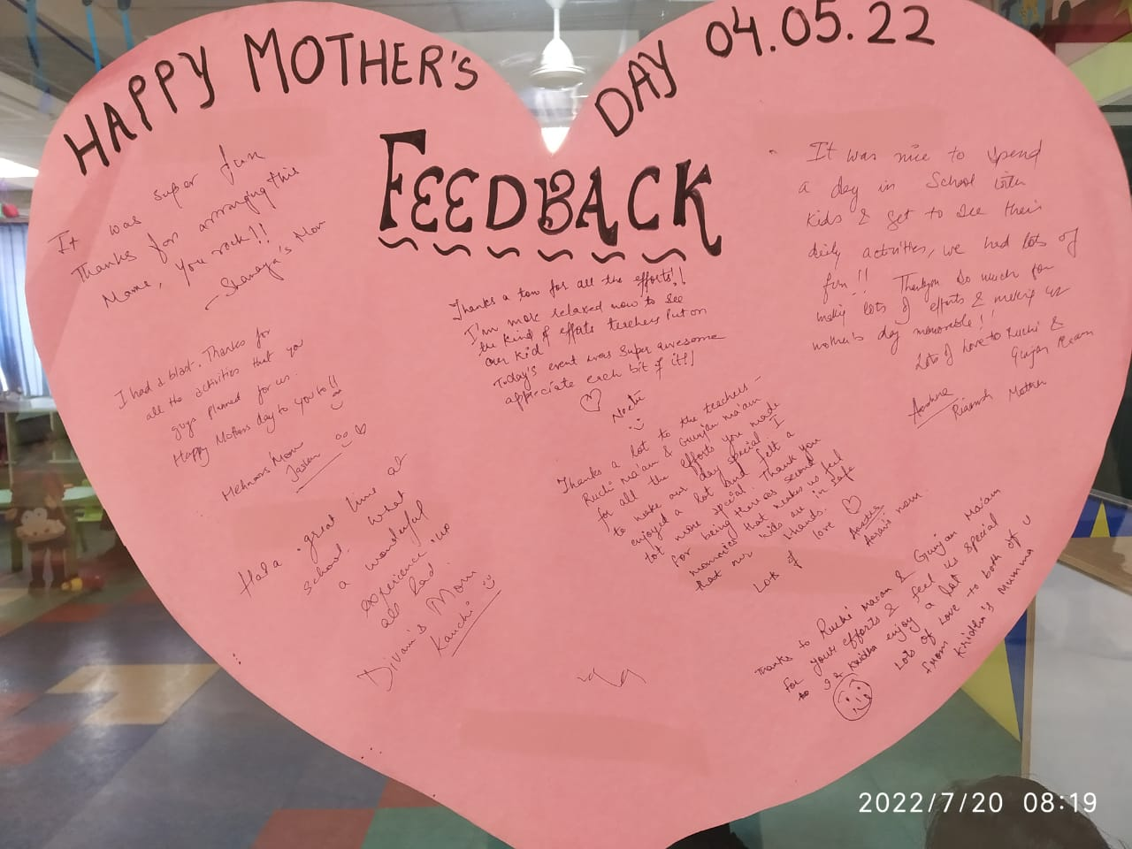
Z
TESTIMONIALS

Slide 11
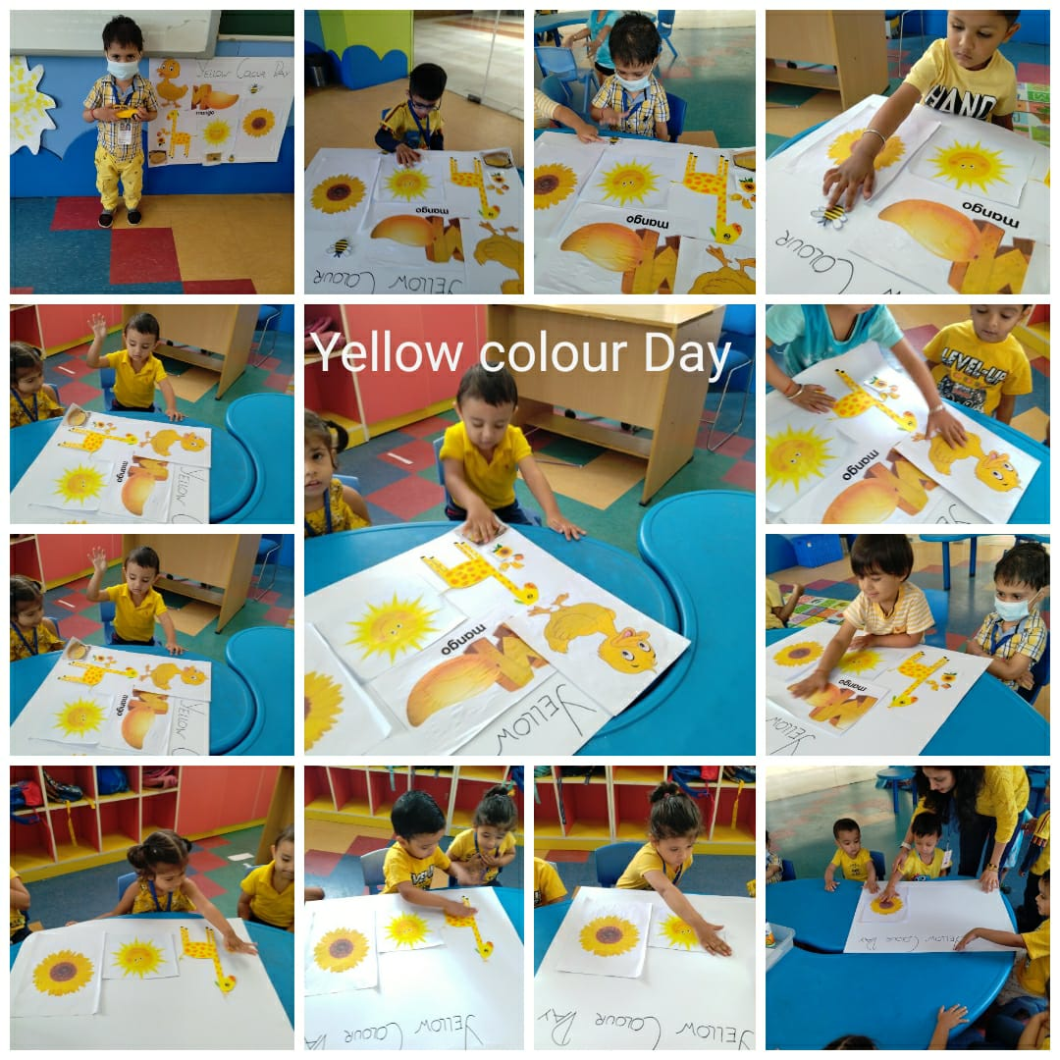
YELLOW DAY
The colour yellow is about optimism, energy, joy and friendship. The beautiful colour was introduced to the children of Pre – Nursery with a celebration. A Yellow day was celebrated with a lot of cheer and enthusiasm. Our little ones came to the class wearing bright yellow dresses and big smiles.
A plethora of activities were conducted to enhance their learning such as sorting and painting. The little munchkins quacked their way to their homes while taking cute yellow ducks homes.

Slide 12
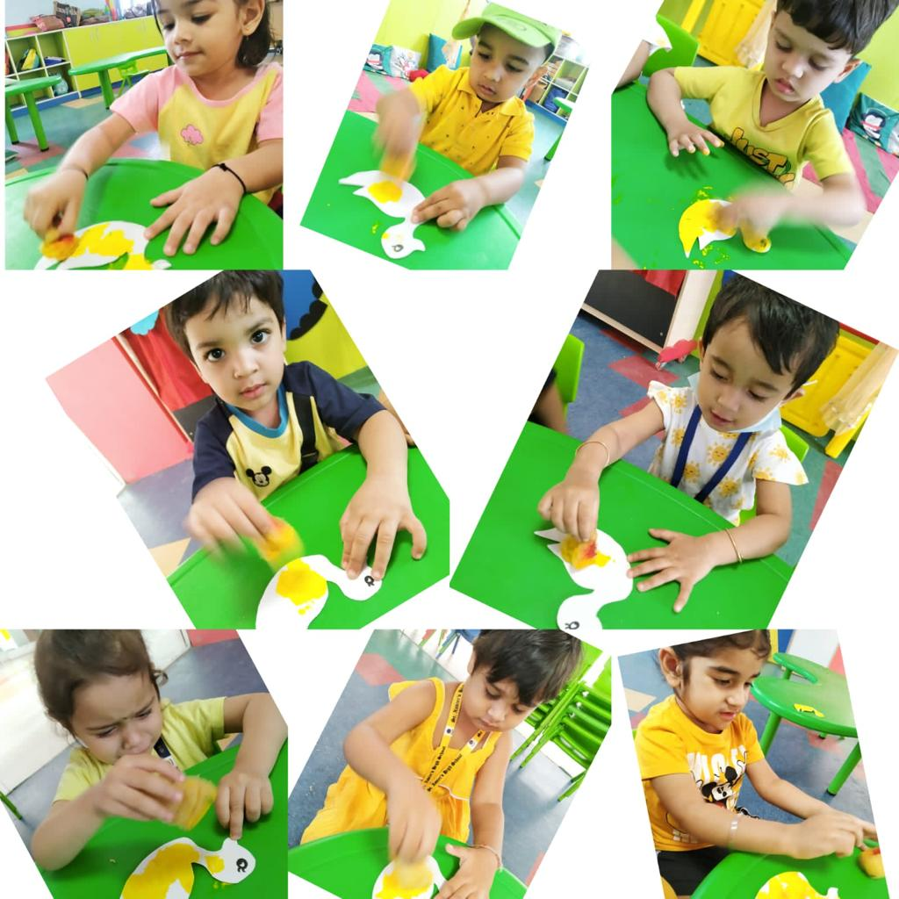
HOW LOVELY YELLOW IS !!

Slide 13
Z
BONDING OVER BREAKFAST
Whether you are eating at home, dining out, or having dinner with friends, good table manners for children are an important part of every meal.
We believe that good nutrition leads to improved classroom performance and better behaviour. The children of Pre-Nursery enjoyed a breakfast session with their teachers and classmates where they not only learnt table etiquettes but also connected bonds with each other.

Slide 14
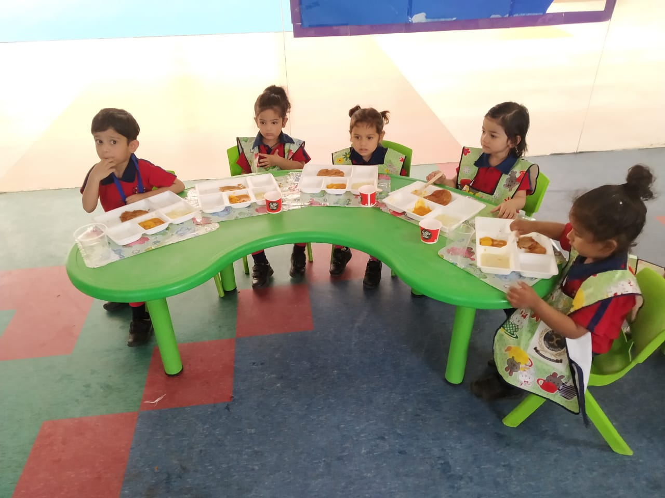
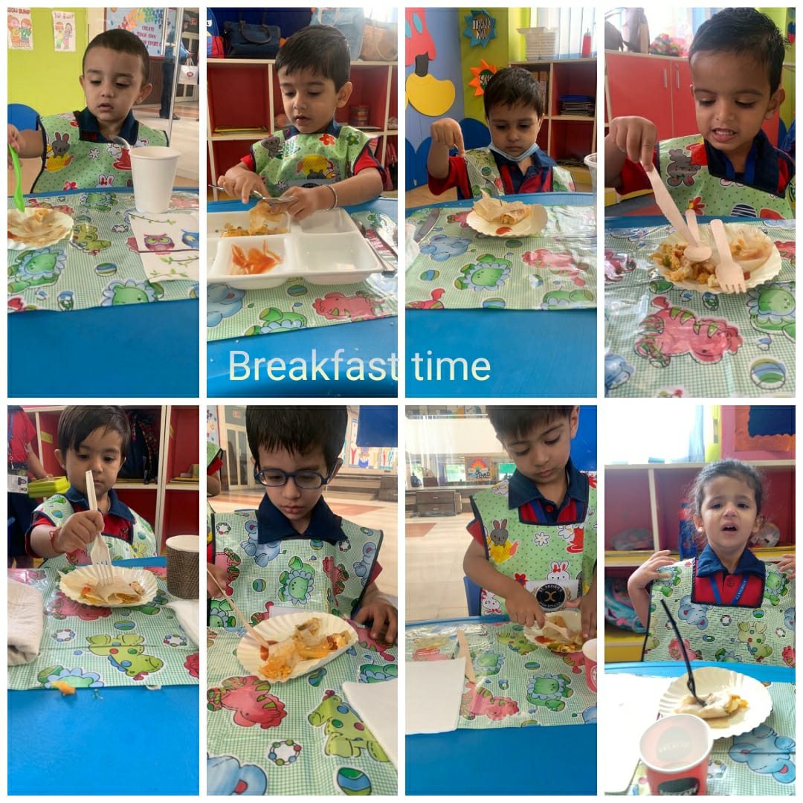
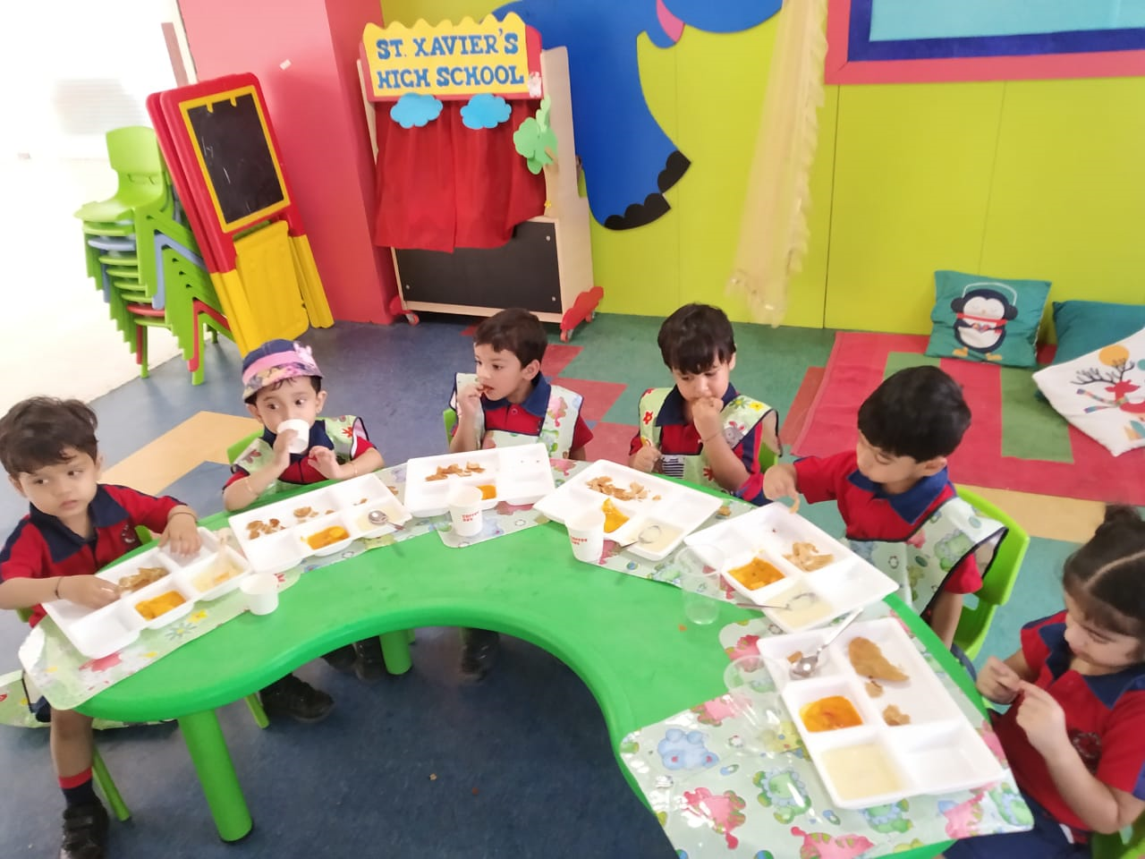

Slide 15
GROWING UP HAS JUST BEGUN!!

